Slide 1
Reinforcement Learning
(Modified from slides by Yijue Hou)

Slide 2
Perspective
Learning takes place as a result of interaction between an agent and the world.
What an agent perceives should be used for acting, and to improve future performance.

Slide 3
Supervised vs. Reinforcement Learning
Supervised learning: sample (input, output) pairs of the function to be learned can be perceived or are given (“by a teacher”).
Reinforcement learning: when an agent acts on its environment, it receives some positive/negative evaluation of its action.

Slide 4
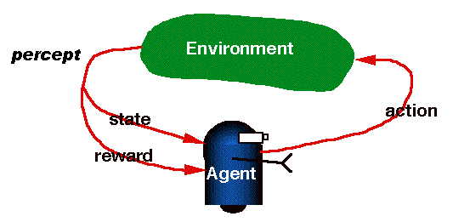
RL = learning from interaction

Slide 5
Credit Assignment Problem
Many actions may have been taken before feedback is provided by the environment.
Which of the prior actions should be rewarded/penalized, and to what extent?
”Good” actions may be penalized just because they were paired with bad ones resulting in punishment.

Slide 6
Examples
Chess: win/loss information only at the end of the game, after many moves. How good/bad was each move?
Traffic Light Control: traffic delays can be measured, but which of the previous actions was wrong?

Slide 7
Modeling the RL task
The state is not hidden.
The agent can determine the Reward/Penalty (reinforcement).
The agent must learn the optimal policy, mapping states to actions, that maximizes reinforcement over the long run.
Can be modeled as a “Markov Decision Process” (MDP).

Slide 8
Markov Decision Process (MDP)
MDP model <S,T,A,R>
S– set of states
A– set of actions
T(s,a,s’) = P(s’|s,a), the unknown probability of transition from s to s’ given action a
R(s,a): the expected reward for taking action a in state s
Agent
State
Action
Reward
Environment
a₀
a1
a2
s₀
s₁
s2
s3
r₀
r1
r2

Slide 9
Model-based vs. Model-free approaches in RL
Model-based RL: learn the model, and use it to derive the optimal policy.
E.g Adaptive dynamic learning (ADP)
Model-free RL: derive the optimal policy without learning the model.
E.g LMS, and Temporal difference

Slide 10
Passive vs. Active learning
Passive learning
The agent observes the environment and tries to learn the “utilities” of being in various states.
Active learning
The agent observes, but also acts.

Slide 11
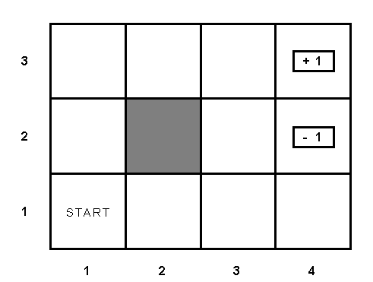
Example environment

Slide 12
Passive learning scenario
The environment generates state transitions and the agent perceives them.
Examples:
(1,1) →(1,2) →(1,3) →(2,3) →(3,3) →(4,3)[+1]
(1,1)→(1,2) →(1,3) →(1,2) →(1,3) →(1,2) →(1,1) →(2,1) →(3,1) →(4,1) →(4,2)[-1]
Key idea: update the utility estimates using the given training sequences.

Slide 13
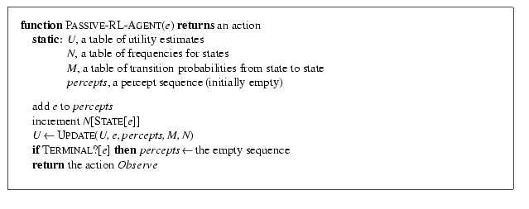
Passive learning scenario

Slide 14
LMS updating
Reward to go of a state: the sum of the rewards during a sequence from that state until a terminal state is reached.
Key: use observed reward to go as evidence of the actual expected utility of that state.
Update utility function based on the sequence.

Slide 15
LMS updating
function LMS-UPDATE (U, e, percepts, M, N ) return an updated U
if TERMINAL?[e] then
{ reward-to-go ← 0
for each ei in percepts (starting from end) do
s = STATE[ei]
reward-to-go ← reward-to-go + REWARDS[ei]
U[s] = RUNNING-AVERAGE (U[s], reward-to-go, N[s])
end
}
function RUNNING-AVERAGE (U[s], reward-to-go, N[s] )
U[s] = [ U[s] * (N[s] – 1) + reward-to-go ] / N[s]

Slide 16
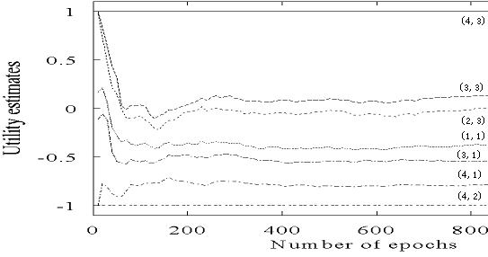
Drawback of LMS updating
The actual utility of a state is constrained to be the probability- weighted average of its successor’s utilities.
Converges very slowly to correct utility values, requiring many sequences, >1000 in our example.

Slide 17
“Temporal difference” (TD) method in passive learning
TD(0): update the estimated utility value of the current state based on its immediate reward and the estimated value of the next state, using the rule:
U(s) converges to the correct value if (the learning rate) decreases when a state is visited more frequently.

Slide 18
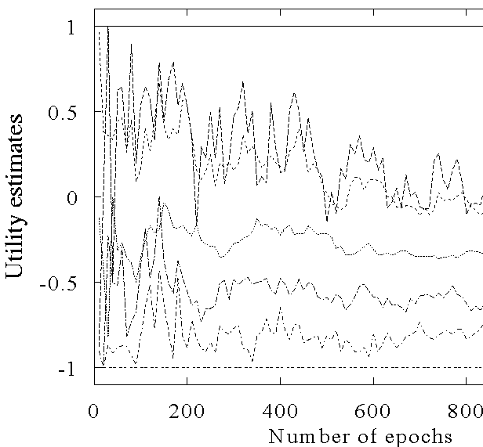
The TD learning curve
(4,3)
(2,3)
(2,2)
(1,1)
(3,1)
(4,1)
(4,2)

Slide 19
Adaptive dynamic programming(ADP) in passive learning
ADP is a model based approach, using the update rule
However, in an unknown environment, T is not given, the agent must learn T itself by experience with the environment.
Challenge: How to learn T?

Slide 20
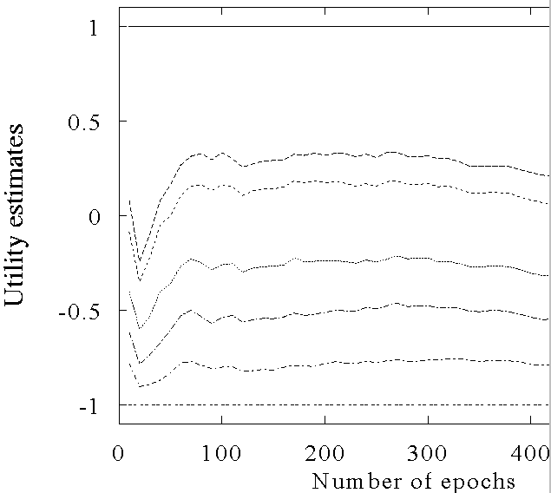
ADP learning curves
(4,3)
(3,3)
(2,3)
(1,1)
(3,1)
(4,1)
(4,2)

Slide 21
Active learning
An active agent must consider:
what actions to take; and
what their outcomes maybe (both on learning and receiving the rewards in the long run).
Update utility equation:
Rule to choose an action:

Slide 22
Active ADP algorithm
For each s, initialize U(s) , T(s,a,s’) and R(s,a)
Initialize s to current state that is perceived
Loop forever
{
Select an action a and execute it (using current model R and T) using
Receive immediate reward r and observe the new state s’
Using the transition tuple <s,a,s’,r> to update model R and T (see further)
Update U(s) , changing s to s’
}

Slide 23
How to learn model in ADP
Use the transition tuple <s, a, s’, r> to learn T(s,a,s’) and R(s,a). That’s supervised learning!
Since the agent can observe every transition (s, a, s’,r) directly, so take (s,a)/s’ as an input/output example of the transition probability function T.
Different techniques can be used in the supervised learning.
Use r and T(s,a,s’) to learn R(s,a)

Slide 24
ADP approach pros and cons
Pros:
ADP algorithm converges much faster than LMS and Temporal learning, because it uses information from the model of the environment.
Cons:
Intractable for large state space, since in each step, we must update U for all states
[This can be improved by prioritized-sweeping.]

Slide 25
Another model free method– TD-Q learning
Define Q-value function
Q-value function updating rule
<*>
Key idea of TD-Q learning
Combined with temporal difference approach
The updating rule
Rule to chose the action to take

Slide 26
TD-Q learning agent algorithm
For each pair (s, a), initialize Q(s,a) ;
Observe the current state s;
Loop forever:
{
Select an action for execution:
Receive immediate reward r and observe the new state s’.
Update
s=s’
}

Slide 27
Exploration problem in Active learning
An action has two kinds of outcome:
Gain rewards on the current experience tuple (s,a,s’).
Affect the percepts received, and hence the ability of the agent to learn.

Slide 28
Exploration problem in Active learning
Tradeoff exists when choosing action to maximize benefit over short term vs. long term.
Two extreme approaches:
Random, hoping to eventually explore the entire environment.
Greedy, acting to maximize utility using current model estimate.

Slide 29
Exploration problem in Active learning
Intermediate approach: the agent should be more random when it has little idea of the environment, and more greedy when it has a model that is close to being correct:
Try new actions about which past experience is absent.
Avoid actions that are believed to be of low utility.
Implemented by exploration function f(u,n):
Assign higher utility estimate to relatively unexplored action-state pairs
Change the updating rule of value function to
U+ denotes the optimistic estimate of the utility

Slide 30
Exploration problem in Active learning
One definition of f(u,n):
if n< N_{e}
u otherwise
is an optimistic estimate of the best possible reward obtainable in any state
The agent will try each action-state pair(s,a) at least N_{e} times
The agent will behave initially as if there were wonderful rewards scattered all over around– optimistic .

Slide 31
Generalization in Reinforcement Learning
So far we assumed that all the functions learned by the agent are (U, T, R,Q) are tabular forms—
i.e., it is possible to enumerate state and action spaces.
Use generalization techniques to deal with large state or action space.
Function approximation techniques

